Slide 1
Biosimilar Entry and the Pricing of Biologic Drugs
Luca Maini (UNC Chapel Hill)
Josh Feng (Utah Eccles)
Thomas Hwang (Harvard Medical School)
Jacob Klimek (UNC Chapel Hill)
Notes:
Hi, my name is Jacob Klimek and I’m a 5th year student at the University of North Carolina at Chapel Hill. I really appreciate the opportunity to get to present, and today I’ll be talking about a joint paper I’m working on with Luca Maini, Josh Feng, and Thomas Hwang titled Biosimilar Entry and the Pricing of Biologic Drugs. We’re currently working on incorporating some feedback we’ve received from past presentations and hoping to submit the paper soon, so I’m really looking forward to hear your feedback and comments.

Slide 2
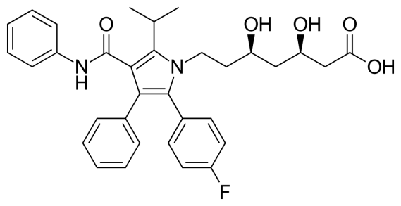
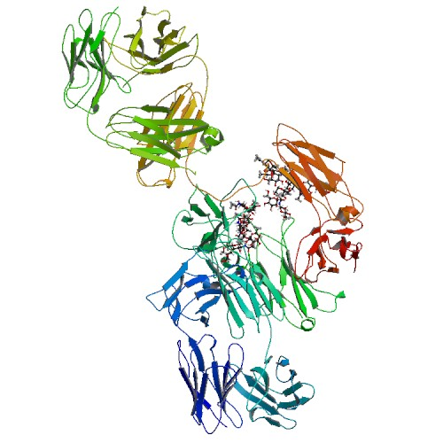
Debate – How to Regulate Biologic Drugs Markets
Drugs approved before 2000
Hatch-Waxman Act deals with regulation after loss of exclusivity (LOE)
Generic entry, 90%+ reduction in brand volume (policymakers generally happy)
Many recent drugs: biologics (e.g., Humira)
2% of prescriptions, 37% of net spending (IQVIA 2017)
BPCIA 2009 addresses regulation after LOE for biosimilars
Biologics seem to be maintaining volume and (list) prices are not going down after loss-of-exclusivity
Potential alternatives
Cost-plus regulations?
Recent bipartisan legislation/proposals: information, formulary ratings
Notes:
So there’s been an ongoing debate and it’s an open question about the best way to regulate biologic drug markets. To better understand where things are at it might be helpful to discuss prescription drug markets as a whole.
Prescription drug markets in the past have been characterized by easy to copy products. To promote innovation, one solution that has been practiced is to grant temporary exclusivity for new brand name drugs.
Drugs approved before roughly 2000 were generally small molecule drugs, one example of which is Lipitor. These drugs are characterized by compounds that can be manufactured and copied exactly, so patents protecting the sales exclusivity of a drug for a certain time incentivizes new drug innovation. But, after a patent expires, regulation on how to approve generics may be helpful.
So, in 1984, the Hatch Waxman Act was signed in part to regulate drug markets after loss of exclusivity. The act encouraged generic entry by streamlining the process and making it simpler.
Then, we see generics enter, brand volume tends to fall by over 90%, and policymakers generally are happy with the results.
TOday, we are seeing a growing share of a different type of drug, namely biologics, in the prescription drug market.
Biologics differ from small molecule drugs in that they are grown from living organisms, and not a chemical compound that’s manufactured.
As a result, they are harder to copy exactly.
Biologics are important in the drug landscape because they tend to be very expensive. They make up about 2% of prescriptions, but 37% of net spending according to a 2017 IQVIA report.
It also just so happens that many biologics are starting to lose exclusivity. So now there is a debate about how to effectively regulate biologics after loss-of-exclusivity in a way similar to Hatch-Waxman.
Beyond just their structures, biologics tend to be different than small molecule drugs in that they tend to take much more time and money to develop.

Slide 3
Research Questions
How do incumbent biologics manufacturers respond to the entry of biosimilars?
Previous work: analyses of list prices; net price evidence from individual markets (San-Juan-Rodriguez et al., 2019)
Our paper: analysis of net price and formulary data using diff-in-diff approach and all available data
Is there heterogeneity in incumbents’ responses?
Variation in response can provide suggestive evidence on the factors driving incumbent response => point to future trends, responses to potential policies
Our paper: compare biosimilars approved through different mechanisms (suggestive evidence)
Notes:
First, we try to answer how do incumbent biologics manufacturers respond to the entry of biosimilars?
This might be important for a couple of reasons:
Answering this question sheds some light about whether or not biosimilars are drugs that should even be encouraged through regulation.
It’s also already clear that biosimilars break away from their small molecule generic counterparts in terms of list price and market penetration. Our results give suggestive evidence about why.
Previous work has focused on list prices or net prices of individual markets. A 2019 paper in JAMA Open by San-Juan-Rodriguez and others graphically looked at the price trend of a few molecules like filgrastim and infliximab.
We analyze the net price and formulary data using a difference in difference approach with data on a large set of drugs in the US market.
Before I get any further, I thought it would be helpful to clarify that we use the term biosimilar somewhat loosely. What I mean by that is there are a few biologic drugs that have either an exact brand name competitor or a similar competitor that was approved through the original biologics application and not the pathway created by the Biologics Price Competition and Innovation Act. One example of this is Granix which was approved through the original BLA because it predated the established pathway created by the FDA. This is not something we do uniquely in the literature, for example, the paper I cited by San-Juan-Rodriguez and others looks at insulin-glargine, and insulins have just in the last year been recodified as biologics allowing for similar drugs to be approved through the biosimilar pathway.
So the second question we look at is whether or not there is heterogeneity in incumbents’ responses along any of our available measures.
A variation in response can provide suggestive evidence on what exactly is driving incumbent responses. This may be important as it would point to future trends, and any potential responses to new policies. Because what we might care about is how to spur competition even more, but it’s clear that incumbent firms are willing to fight entrants.
To answer this question, we compare biosimilars approved through different mechanisms, namely the abbreviated pathways and other means of approval.

Slide 4
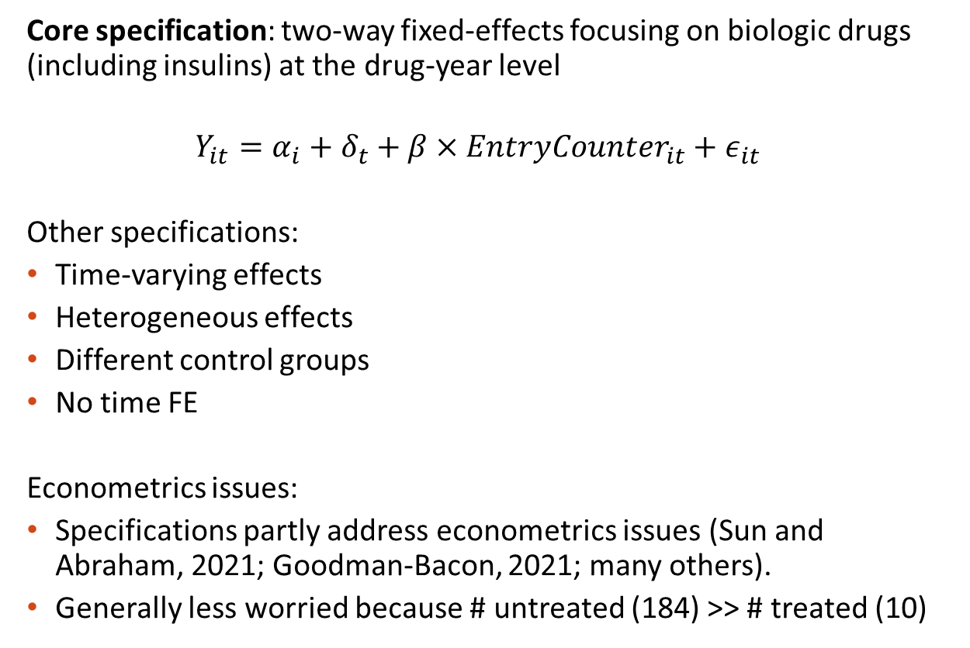
Empirical Approach
Core specification: two-way fixed-effects focusing on biologic drugs (including insulins) at the drug-year level
$$Y_{it}=α_{i}+δ_{t}+β×EntryCounter_{it}+ε_{it}$$
Other specifications:
Time-varying effects
Heterogeneous effects
Different control groups
No time FE
Econometrics issues:
Specifications partly address econometrics issues (Sun and Abraham, 2021; Goodman-Bacon, 2021; many others).
Generally less worried because # untreated (184) >> # treated (10)
Notes:
Our core specification is a straightforward two-way-fixed-effects approach focusing on biologic drugs including insulins at the drug-year level.
We also modify the regression to allow for there to be time-varying effects. This boils down to interacting the entry counter with a year since entry indicator.
As discussed earlier, we split out the biologics and see if there are heterogeneous effects of entry for different pathways.
One example of a different control group used was limiting to specific classes of drugs that see a biosimilar enter within class. Our results are generally robust to choice of control group
There have been recent econometric developments that have called into question the validity of two-way fixed-effects without further adjustments.
Specifically, the Sun and Abraham paper discusses modifications that can be made when “treatment” timing varies across treated observations.
Our specification of an entry counter partially addresses these issues.
Also, when the number of untreated observations is much larger than the number of treated we’re less worried because one of the main concerns is that future treated observations serving as controls for past treated events, and with a large control group.
We also are fighting up against having a limited number of treated observations so there’s only so much we can do. But the solution might not necessarily be to just wait for more data because it’s clear the policy landscape affecting biologics is not stationary so comparisons over an even larger time span will have issues with identifying a treatment effect.
Talk about limitations
We don’t have a lot of data
But more data might exacerbate other identification issues.

Slide 5
Minimal List Price Response, Negative Response in Net Price, Noisy Volume Response
 | Log(WAC) | Log(net price) | Log(units)
Biosimilar Entry Counter | 0.0322 | -0.173** | -0.0579
 | (0.0489) | (0.0645) | (0.130)
Fixed Effects | Year | Year | Age
Observations | 1438 | 1438 | 1438
Note: Standard errors are clustered at the product level
Notes:
Okay, so now let’s discuss results from our main specification.
First, we see biosimilar entry is not associated with a change in the log of the wholesale acquisition cost.

Slide 6
Minimal List Price Response, Negative Response in Net Price, Noisy Volume Response
 | Log(WAC) | Log(net price) | Log(units)
Biosimilar Entry Counter | 0.0322 | -0.173** | -0.0579
 | (0.0489) | (0.0645) | (0.130)
Fixed Effects | Year | Year | Age
Observations | 1438 | 1438 | 1438
Note: Standard errors are clustered at the product level
Notes:
But it is associated with a statistically significant decrease in net price. The coefficient translates to a roughly 19% drop in
We also see no effect of entry on units sold. Keeping with the literature, we use age fixed effects for the units sold.

Slide 7
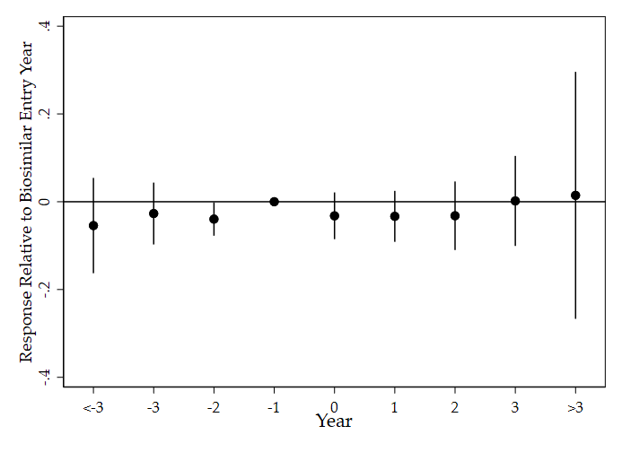
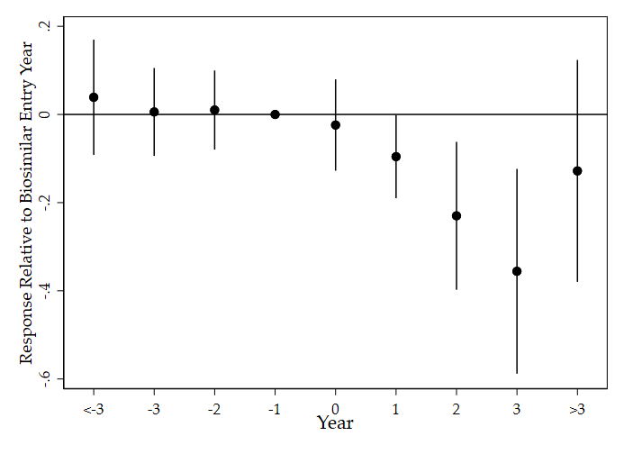
Allowing for Time-Varying Responses
Log(WAC)
Log(net)
Notes:
Looking at the specification where we allow the coefficient to change with the number of years post entry, we see a similar pattern. WAC does not change, but within the first year we see a statistically significant decrease in net price that decreases over time
Clarify the specification.
WAC does not change after a biosimilar enters, while net price decreases steadily.

Slide 8
Slightly Worse Formulary Coverage for Incumbent Biologics
 | Preferred | Unrestricted | Covered
Biosimilar Entry Counter | -0.0392** | -0.0227** | -0.0305
 | (0.0112) | (0.0108) | (0.0194)
Fixed Effects | Year | Year | Year
Observations | 552 | 552 | 552
Context | AVG: 0.2 SD: 0.17 | AVG: 0.43 SD: 0.23 | AVG: 0.86 SD: 0.11
Note: Standard errors are clustered at the product level
Notes:
We also look at the affect of biosimilar entry on formulary status. Formulary status dictates how preferred the drug is by the payer, and drugs with better formulary status are likely to be reimbursed more.
We see that formulary coverage gets slightly worse for incumbent biosimilars after entry.
Our classification of preferred, unrestricted, and covered follows Geruso et al., 2019. Their paper breaks down the MMIT formulary classifications into several groups. The outcome of preferred refers to whether the drug had preferred or generic coverage. Unrestricted means that there were no restrictions like prior authorization/step or medical. Covered just means the drug is covered on the plan at all.
We do not observe a statistically significant change in coverage status, but we do see drugs getting bumped out of the preferred and unrestricted tiers.

Slide 9
Discussion of Core Findings
Robustness: raw descriptive evidence, different controls, ASP data
Using price to deter entry?
Evidence: no clear price response by incumbents after FDA approval of competing biosimilar
Likely to be more focused on patent litigation as a deterrent
If patent channel is weakened through regulation, might see different price response to approval
Big picture
Biosimilar competition is bringing down costs, just in a different way relative to generics:
Small molecule drugs: maintain price, lose 90%+ in volume
Formularies: generics automatically slotted into lowest copay tier
Results consistent with story of incumbents offering larger rebates to maintain formulary position
List price => no response
Notes:
We also examine raw descriptive evidence like drug and molecule specific trend graphs. We try different sets of controls, and we also used average sales price data to have ASP as an outcome. This wasn’t included in our main specification because the sample is smaller due to limited data. But in general, the robustness checks yield similar evidence to the story we find in our main specification.
So is price being used to deter entry? We tested an additional specification where we used FDA approval of a competing biosimilar and we saw no change in WAC or in net price after the approval of a drug.
So it seems likely that incumbent firms are more focused on patent litigation as a deterrent, although this is not something we could test in our data. If the patent channel is weakened through regulation, we might see a different price response after approval. To be clear, we don’t necessarily mean a drop in the list price, but potentially a drop in the net price.
The big picture takeaways are that biosimilar competition actually is bringing down costs, just in a way that’s different relative to generics. As we covered earlier, small molecule drugs maintain price, lose 90% of their volume, and generics are automatically slotted into the lowest copay tier.
These results are consistent with a possible story where incumbents offer larger rebates to maintain formulary position while keeping the list price steady.

Slide 10
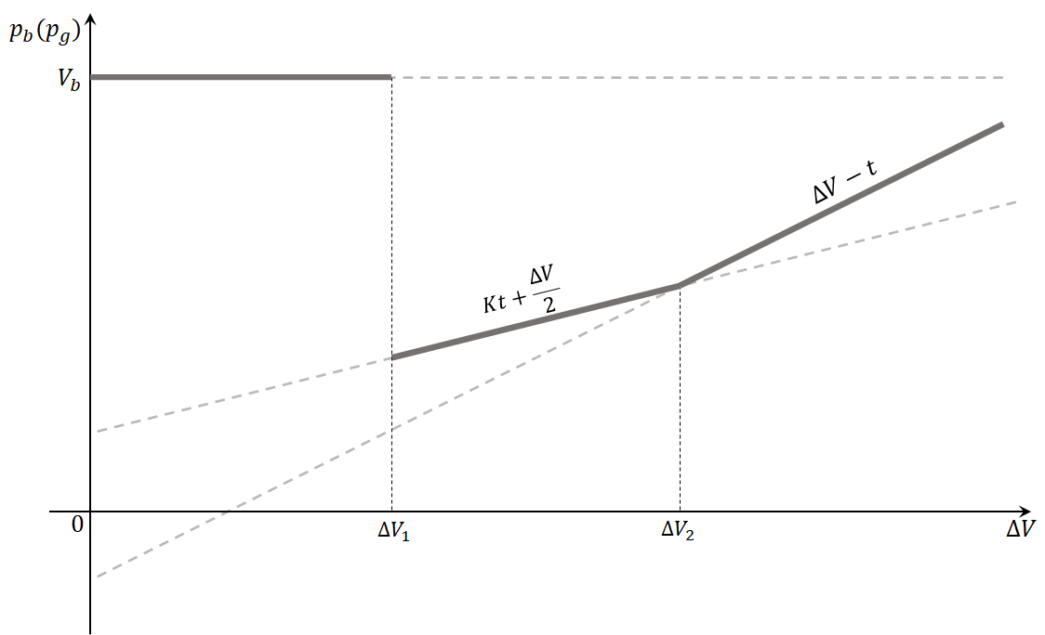
Heterogeneous Response Based on Entry Type?
What might be driving the different response by biologic incumbents vs. small molecule?
Difference is consistent with a model based on Frank and Salkever (1992)
FS: some loyal consumers
Incumbent response differs based on difference perceived by other consumers
Incumbents will choose to not compete on prices if the entrant is perceived to be similar enough
Exploit regulatory quirks to test this hypothesis within biologics
A few biosimilars were approved through “regular” approval channel for approving branded drugs
Tested on a larger sample, go beyond showing “equivalence”
Potentially perceived to have higher quality
Note: imperfect test
Notes:
Frank and Salkever

Slide 11
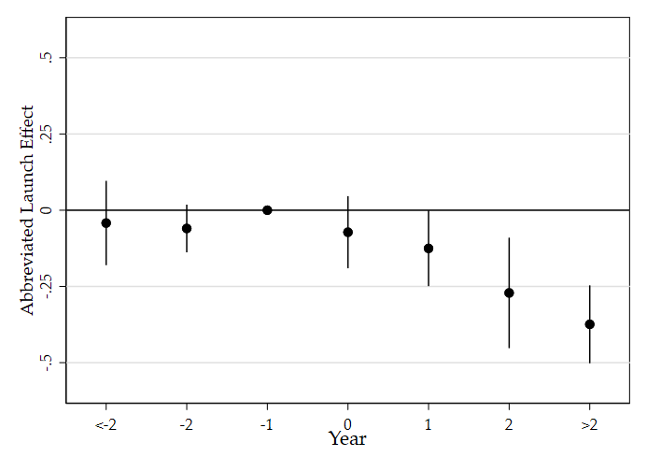
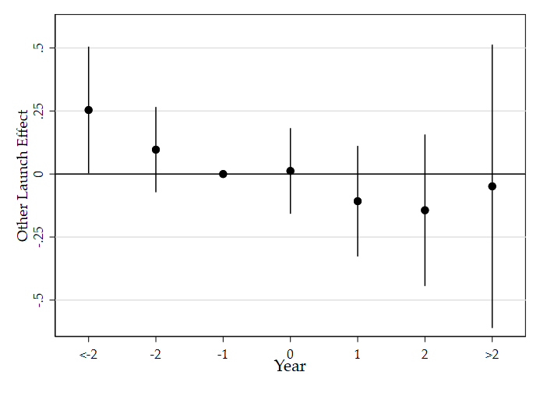
Suggestive Evidence – Net Prices
Abbreviated
Other
Very noisy zero effect for “other”, point estimates generally less than those for “abbreviated”
Notes:
The regression specification is log linear, so two years after biosimilar entry we observe the net price of the incumbent drug falling by about 25%.

Slide 12
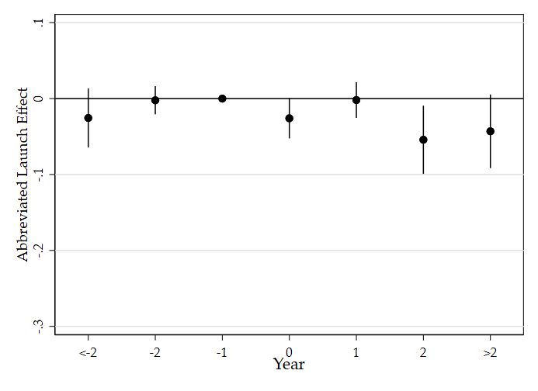
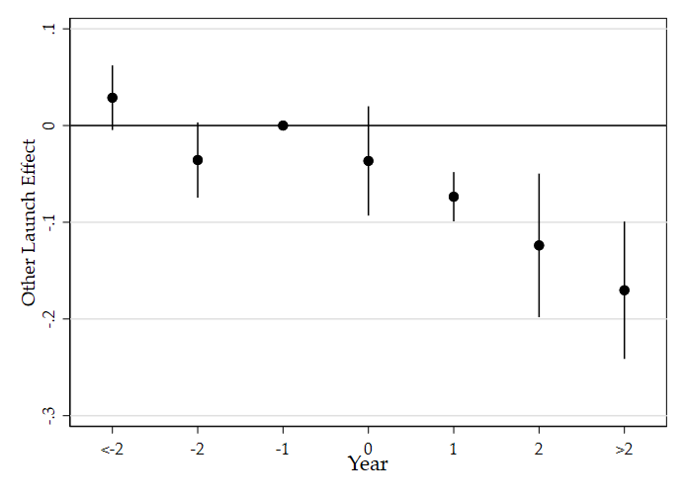
Suggestive Evidence – Formulary Coverage Rate
Abbreviated
Other (Noisy)
Noisy effect for other (again), but larger subsequent coverage decrease (point estimate) than for abbreviated (AVG: 0.86
SD: 0.11). Similar patterns for other coverage outcomes.
Notes:
So we do see this differential response when a biosimilar enters through the abbreviated pathway or through some other means.
When a biologic enters through an abbreviated pathway we observe a decrease in the net price with no drop in net price when a biosimilar enters through another means.
But, we observe a decline (although noisy) in formulary coverage for the other category of entrant and no drop in coverage for the abbreviated pathway.
This is just coverage rates, but we see a similar pattern for preferred and restricted rates as well.

Slide 13
Summary
Provided evidence on the nature of competition between biologics and biosimilars under the current regulatory regime
Biologics offer greater discounts to maintain formulary position
Some evidence of heterogeneity by approval process
Implications
Biologics are currently competing on price
Potential policy implication of suggestive evidence
Greater consumer familiarity with biosimilars could move incumbent response towards those observed for small molecule incumbents
Advancing Education on Biosimilars Act (signed on 4/23/2021)
Notes:
One thing that could potentially be looked at in the future is how insulins respond to the new policy shock of being classified as biologics opening up the pathways for biosimilars to enter through the abbreviated pathway.

